Slide 1

Systematic Trading Education Certificate Lecture 2

Slide 2
Outline of the STEC
Session 1 Introduction - 5th March
Introduction to systematic trading and financial basics
Momentum strategies including relative and cross sectional momentum
Session 2 Mean Reversion - 12th March
Mean reversion strategies and Fibonacci strategies
Value strategies
Session 3 – 19th March
ML models
Sentiment analysis

Slide 3
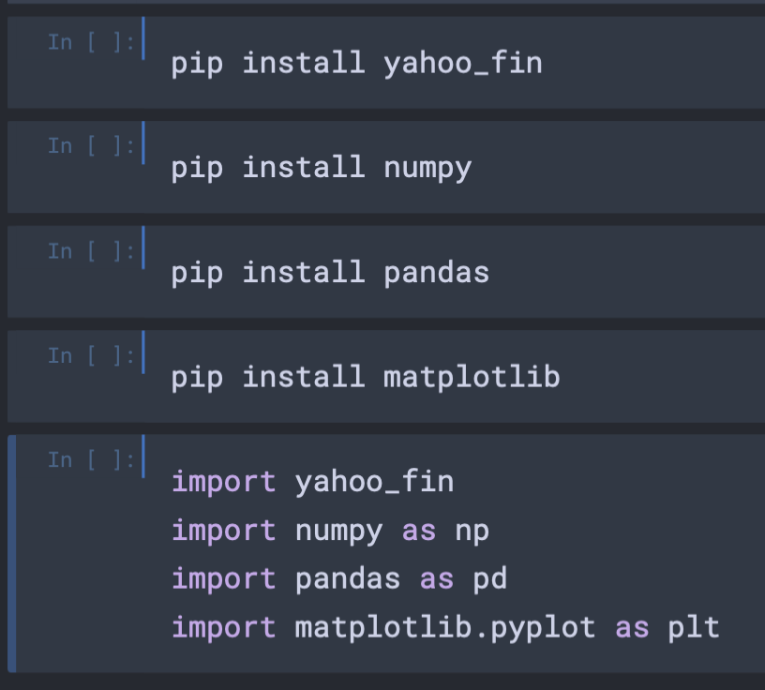
CAPM Strategy - Installing Python Packages
Open the notebook that was sent to you yesterday.
Enter the following chunks and then click run all.
pip install followed by the package name installs a python package onto you computer’s server
Import as then calls this package from your computer’s server and imports it into your current session

Slide 4
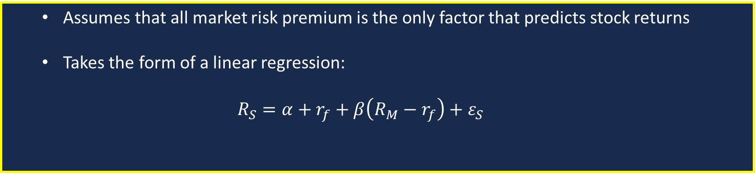
Capital Asset Pricing Model Overview
Investment Risk Factors
Industry
Capital Structure
Macroeconomic Factors
Market returns can serve as a summary statistic for total risk exposure.
Market Risk
Capital Asset Pricing Model
Assumes that all market risk premium is the only factor that predicts stock returns
Takes the form of a linear regression:
$$R_{S}=α+r_{f}+β\left(R_{M}−r_{f}\right)+ε_{S}$$

Slide 5
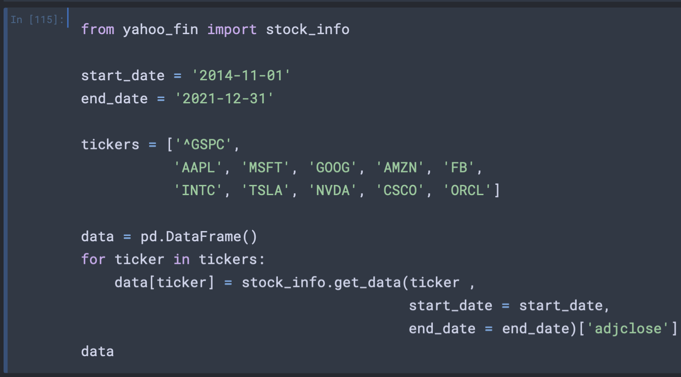
Importing your data into the notebook
Define start and end dates for your data received from yahoo finance.
Define the list of tickers that you wish to receive data for.
Create an empty DataFrame or table that will eventually store all our financial times series data.
Now loop through the list of tickers using a for loop and use the stock_info, sub package and the get_data function to download adjusted close data for each ticker.
Add this data to our DataFrame with the column name given by each individual ticker.

Slide 6
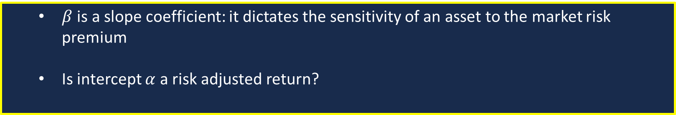
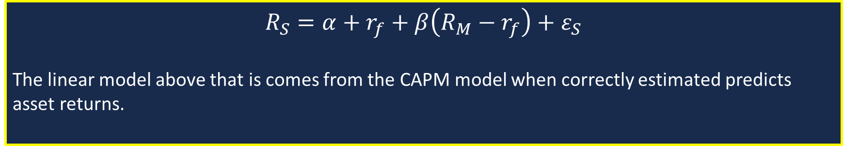

Strategy Hypothesis
Conjecture:
$$R_{S}=α+r_{f}+β\left(R_{M}−r_{f}\right)+ε_{S}$$
The linear model above that is comes from the CAPM model when correctly estimated predicts asset returns.
Do we focus on $α$ or $β$ :
$β$ is a slope coefficient: it dictates the sensitivity of an asset to the market risk premium
Is intercept $α$ a risk adjusted return?

Slide 7
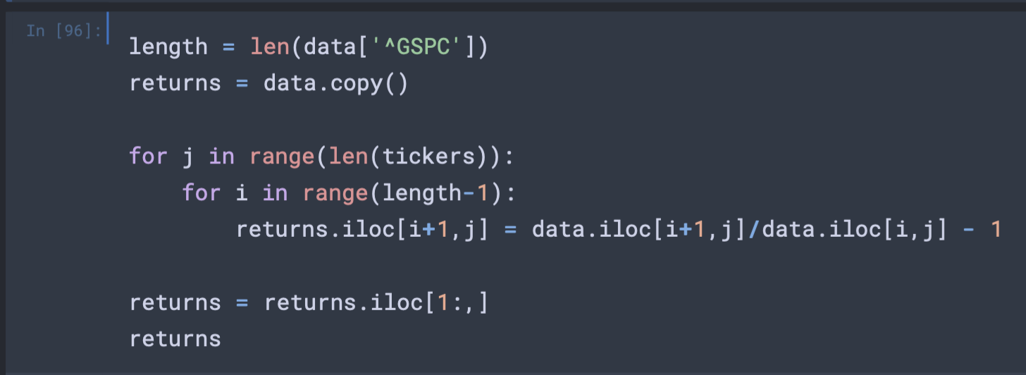
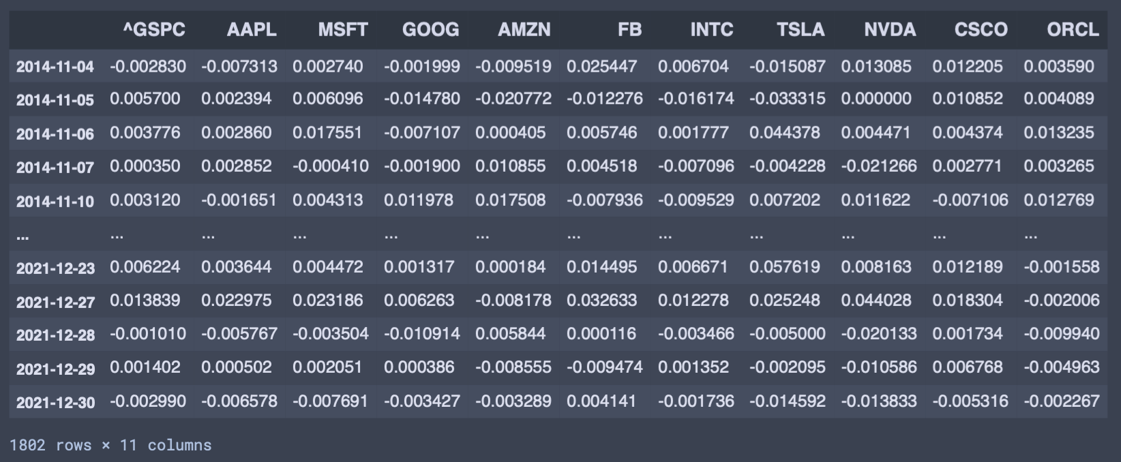
Code for Calculating Daily Returns
First we create a copy of the data to calculate returns with. This is good practice as you are then always able to access the original data.
To calculate the daily returns, we use the index locate pandas inbuilt function.
TO demonstrate how this works returns.iloc[i,j] is the value of the returns DataFrame at the jth column of the ith row.
Using this we can calculate all returns for each stock at every time.
It is also possible to use the pandas function .pct_change() to calculate returns however this is more complicated.
Output of the above code

Slide 8
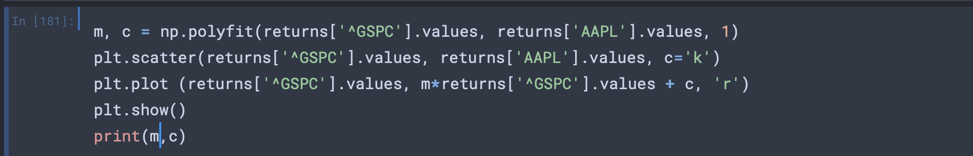
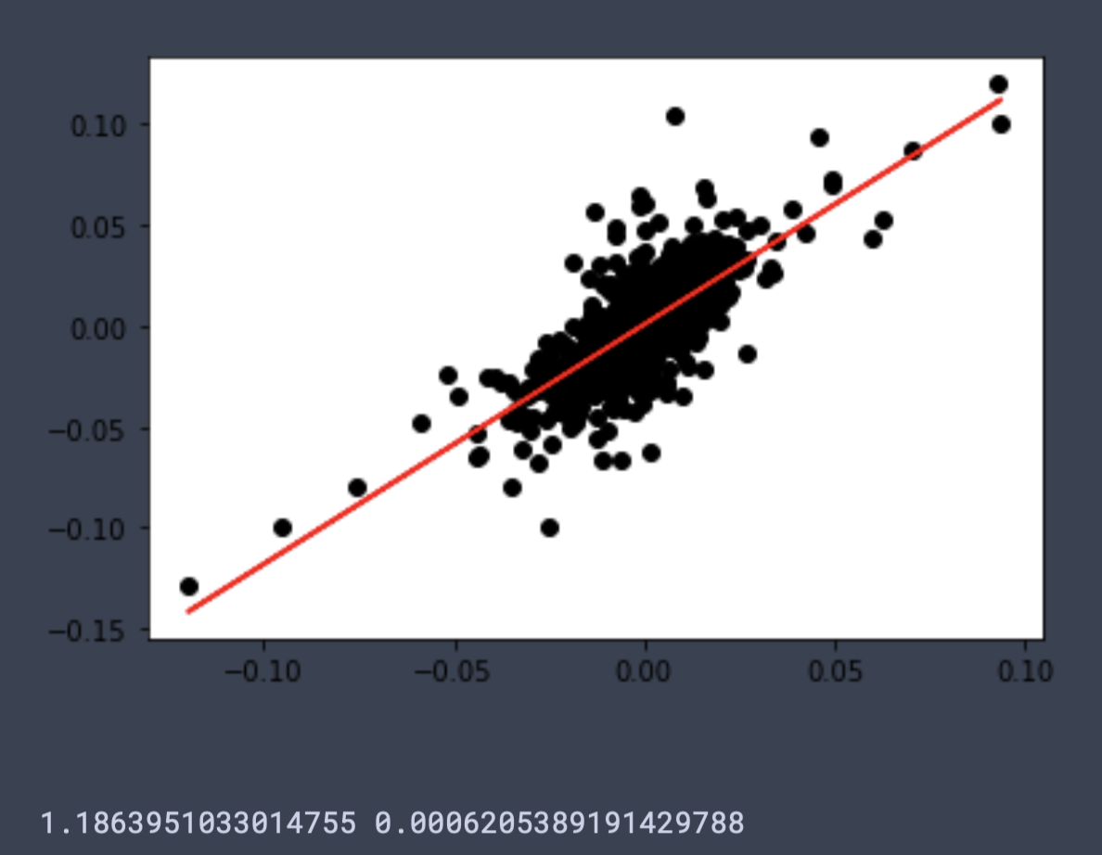
Code for Calculating Coefficients of the Linear Model
First we fit a linear model to the returns of two assets in this case the S&P 500 and apple stock
The remaining code then plots the linear model and scatter plot of returns using the python package matplotlib. This code also outputs the values of the gradient and intercept.
Output of the above code

Slide 9
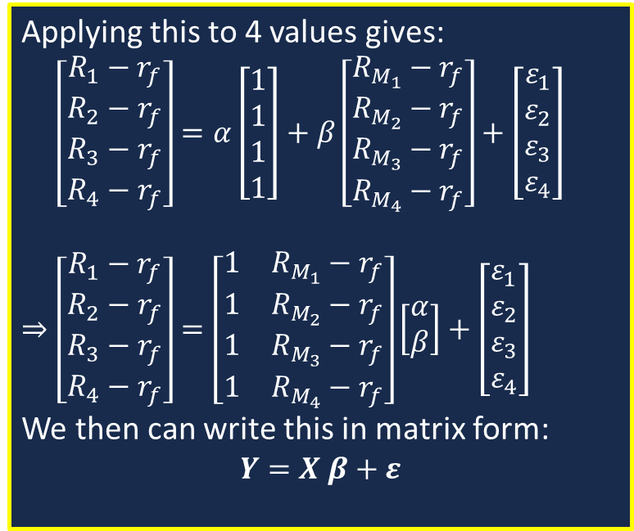
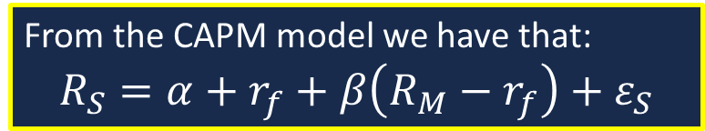
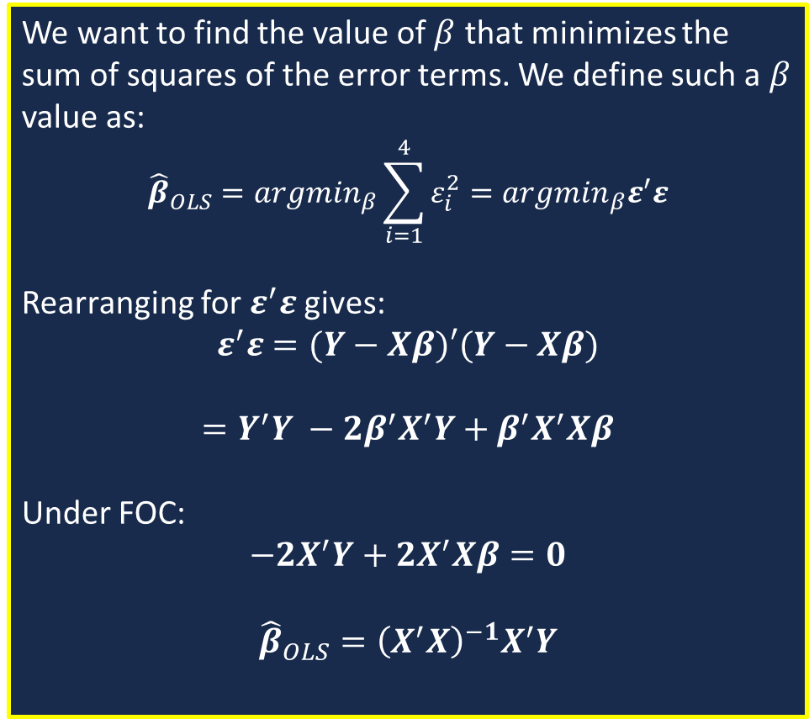
Ordinary Least Squares Regression Formula (4 observation derivation)
1
From the CAPM model we have that:
$$R_{S}=α+r_{f}+β\left(R_{M}−r_{f}\right)+ε_{S}$$
3
We want to find the value of $β$ that minimizes the sum of squares of the error terms. We define such a $β$ value as:
$${\hat{β}}_{OLS}={argmin}_{β}\sum_{i=1}^{4}{ε_{i}^{2}}={argmin}_{β}ε^{′}ε$$
Rearranging for $ε^{′}ε$ gives:
$$ε^{′}ε=(Y−Xβ)′(Y−Xβ)$$
$$=Y^{′}Y −2β^{′}X^{′}Y+β^{′}X^{′}Xβ$$
Under FOC:
$$−2X^{′}Y+2X^{′}Xβ=0$$
$${\hat{β}}_{OLS}={\left(X^{′}X\right)}^{−1}X^{′}Y$$
2
Applying this to 4 values gives:
$\left[\begin{matrix}R_{1}−r_{f} \\ R_{2}−r_{f} \\ R_{3}−r_{f} \\ R_{4}−r_{f}\end{matrix}\right]=α\left[\begin{matrix}1 \\ 1 \\ 1 \\ 1\end{matrix}\right]+β\left[\begin{matrix}R_{M_{1}}−r_{f} \\ R_{M_{2}}−r_{f} \\ R_{M_{3}}−r_{f} \\ R_{M_{4}}−r_{f}\end{matrix}\right]+\left[\begin{matrix}ε_{1} \\ ε_{2} \\ ε_{3} \\ ε_{4}\end{matrix}\right]$
$$⇒\left[\begin{matrix}R_{1}−r_{f} \\ R_{2}−r_{f} \\ R_{3}−r_{f} \\ R_{4}−r_{f}\end{matrix}\right]=\left[\begin{matrix}1 & R_{M_{1}}−r_{f} \\ 1 & R_{M_{2}}−r_{f} \\ 1 & R_{M_{3}}−r_{f} \\ 1 & R_{M_{4}}−r_{f}\end{matrix}\right]\left[\begin{aligned}α \\ β\end{aligned}\right]+\left[\begin{matrix}ε_{1} \\ ε_{2} \\ ε_{3} \\ ε_{4}\end{matrix}\right]$$
We then can write this in matrix form:
$$Y=X β+ε$$

Slide 10
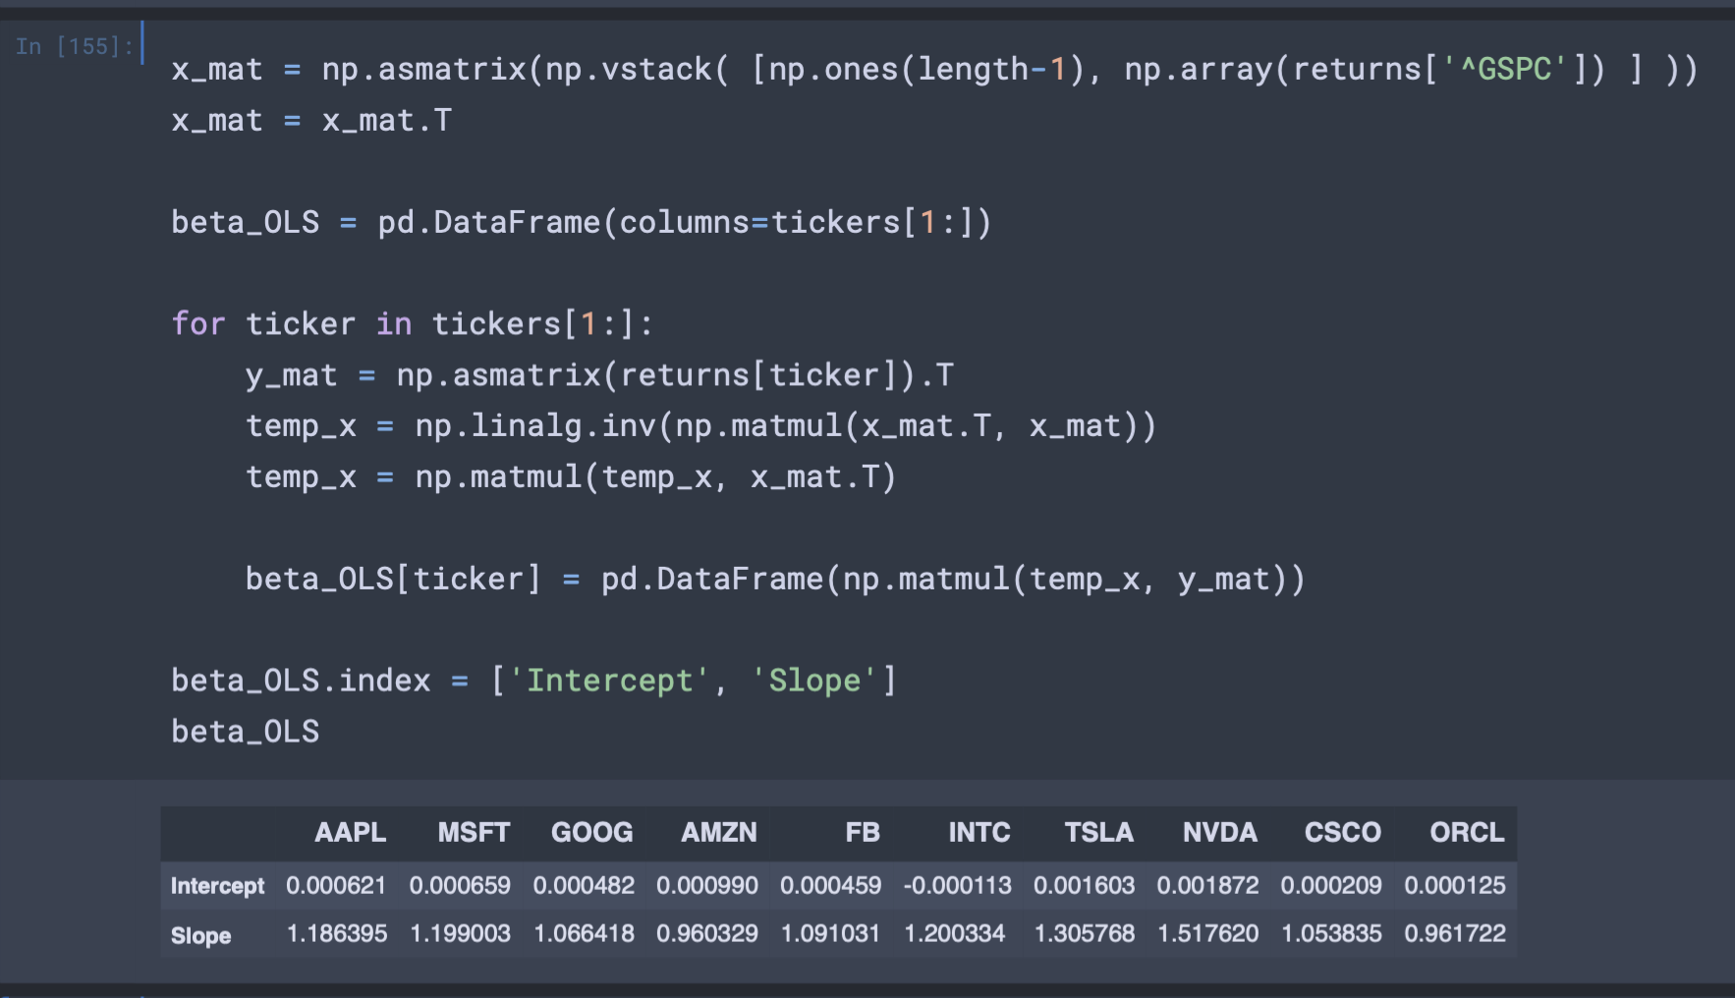
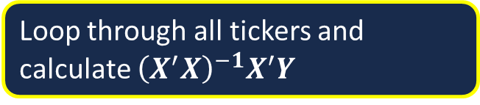
Code for Calculating the LSE of each Ticker Compared to the S&P 500
Define the initial values that make up the matrix X as defined before
Loop through all tickers and calculate ${\left(X^{′}X\right)}^{−1}X^{′}Y$
Read in the values of the intercept and slope into the beta_OLS DataFrame.
Output of result

Slide 11
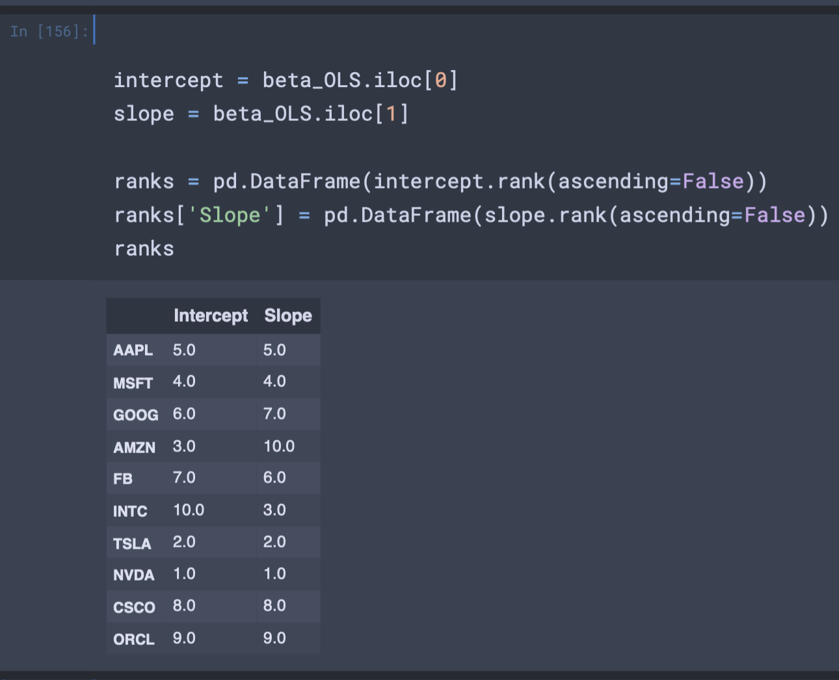
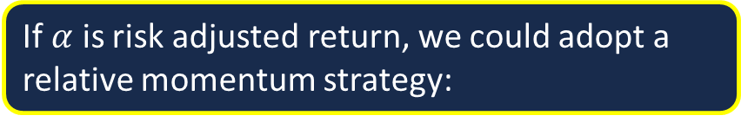
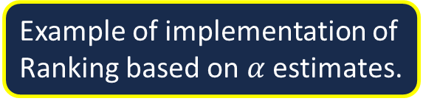
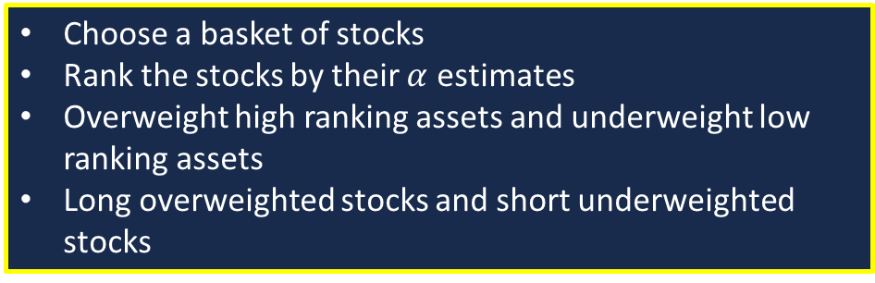
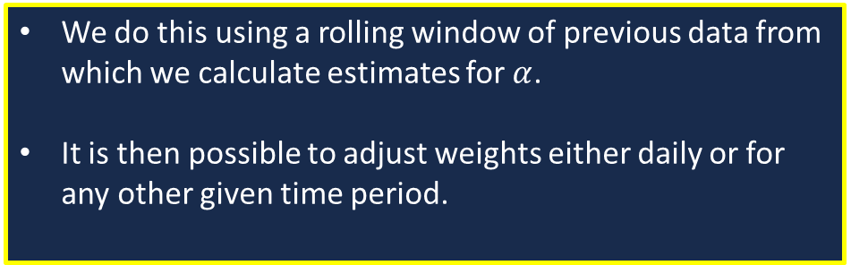
Relative Momentum Approach
If $α$ is risk adjusted return, we could adopt a relative momentum strategy:
Example of implementation of Ranking based on $α$ estimates.
Choose a basket of stocks
Rank the stocks by their $α$ estimates
Overweight high ranking assets and underweight low ranking assets
Long overweighted stocks and short underweighted stocks
Implementation
We do this using a rolling window of previous data from which we calculate estimates for $α$.
It is then possible to adjust weights either daily or for any other given time period.

Slide 12
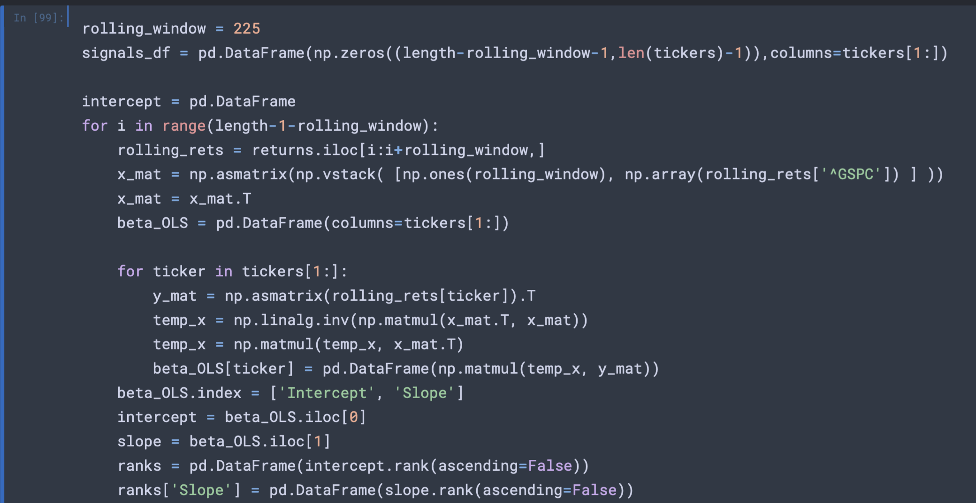
Relative Momentum Approach in Code
This is a combination of all the code we have looked at so far!
The first part calculates the values of beta_OLS at each time index using all the data from the rolling window.
The next section orders the intercept values so that we can begin to start weighting each stock

Slide 13
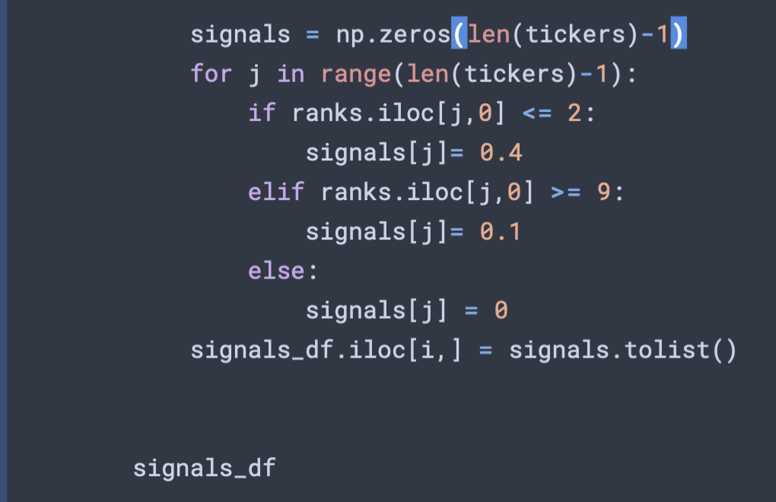
Signal generation (within the for loop)
To calculate our portfolio weights we need to assign a value to each asset at each time interval. These weights will be based on the position of each asset in terms of ranked values of $α$.
For the top two estimates we will give these each a weighting value of 0.4
For the worst 2 values we shall give a weighting of 0.1
All other values will have a weighting of 0.

Slide 14
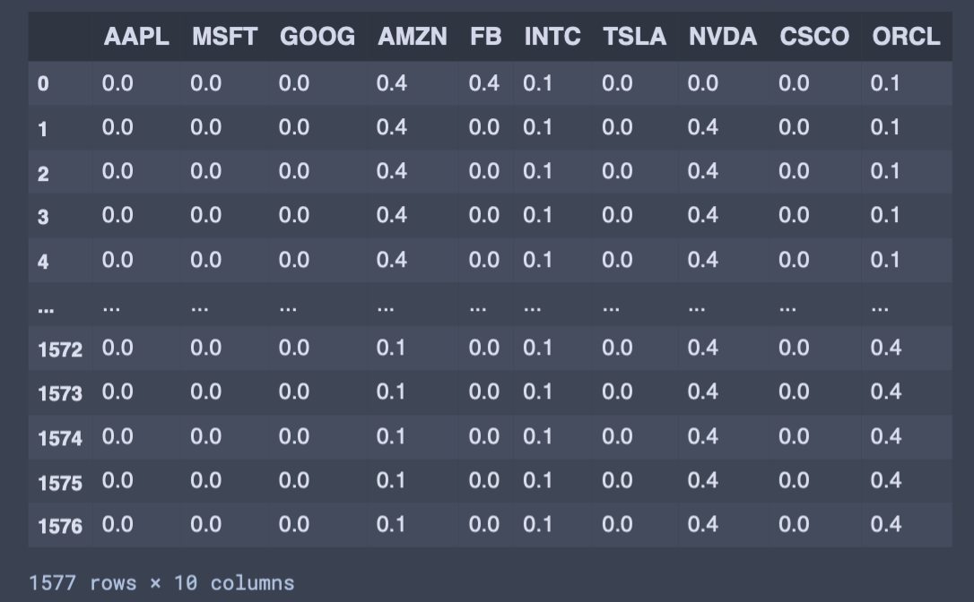
Signal generation (within the for loop) Continued.
The image below shows the output of our strategy weightings applied to a set of assets.

Slide 15
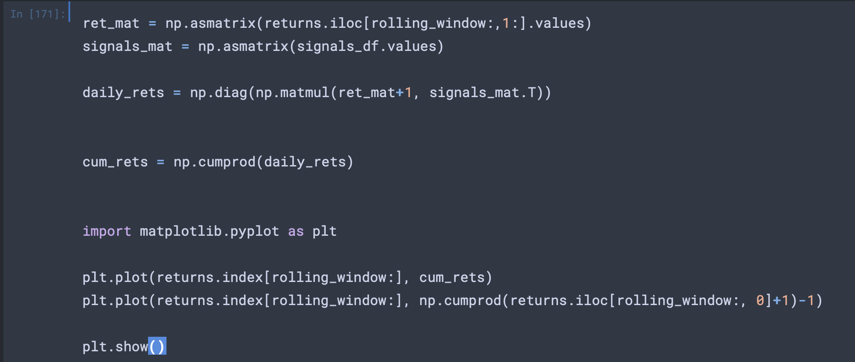
How Did We Do?
Calculate the daily returns of the strategy
Calculate the cumulative product of the daily returns.
Plot the cumulative returns as visualisation of the strategy

Slide 16
How can we Improve?

